Slide 1

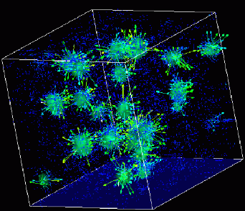

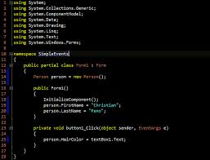
Advanced
Scientific Computing
(SciComp 201)
Session 32 Computational Chemistry

Slide 2
Session Goals
Balance ionic chemical equations using linear programming
Correlate “principle of atom conservation” (POAC) to the minimization of an objective function
Represent molar & charge ratios as linear constraints
Implement brute-force searching using a stack data structure instead of recursion or nested for() loops

Slide 3

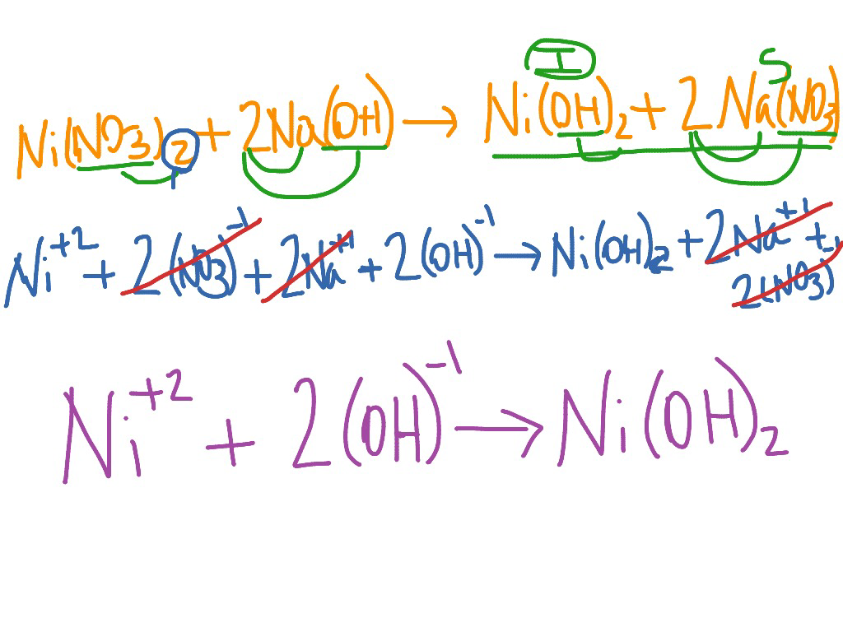
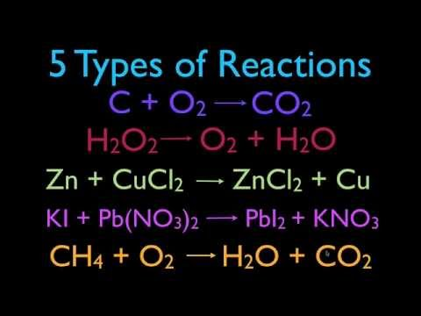
Balancing Ionic Equations
Can we write a program balance ionic equations?

Slide 4
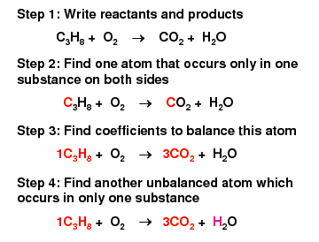
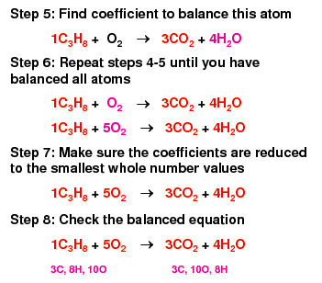
Balancing Ionic Equations
Yikes - and this is not even ionic!

Slide 5
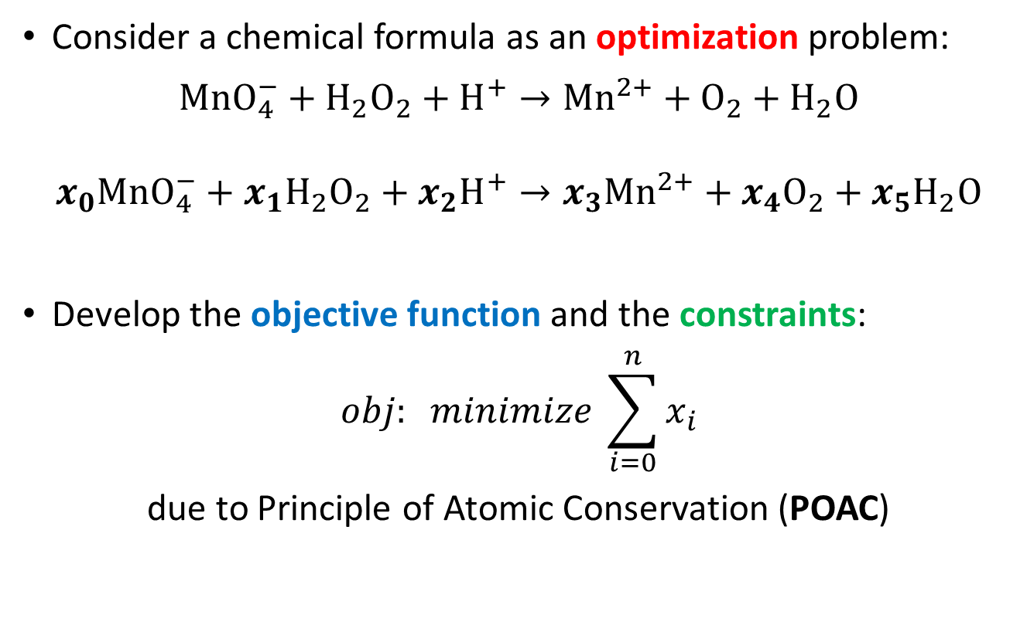
Chemistry is Optimization
Consider a chemical formula as an optimization problem:
$$MnO_{4}^{−}+H_{2}O_{2}+H^{+}→{Mn}^{2+}+O_{2}+H_{2}O$$
$$x_{0}MnO_{4}^{−}+x_{1}H_{2}O_{2}+x_{2}H^{+}→x_{3}{Mn}^{2+}+x_{4}O_{2}+x_{5}H_{2}O$$
Develop the objective function and the constraints:
$$obj: minimize \sum_{i=0}^{n}{x_{i}}$$
due to Principle of Atomic Conservation (POAC)

Slide 6

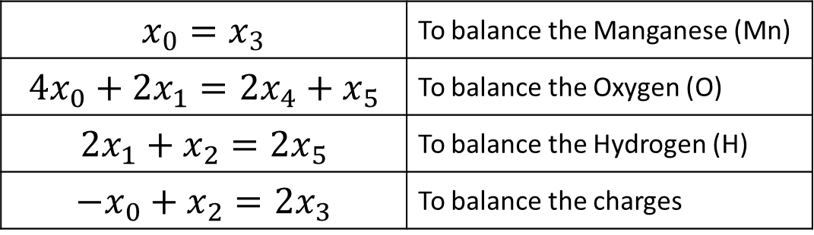
Chemistry is Optimization
$$x_{0}MnO_{4}^{−}+x_{1}H_{2}O_{2}+x_{2}H^{+}→x_{3}{Mn}^{2+}+x_{4}O_{2}+x_{5}H_{2}O$$
$$obj: minimize \sum_{i=0}^{n}{x_{i}}$$
$$x_{0}=x_{3}$$ | To balance the Manganese (Mn)
$${4x}_{0}+2x_{1}={2x}_{4}+x_{5}$$ | To balance the Oxygen (O)
$${2x}_{1}+x_{2}={2x}_{5}$$ | To balance the Hydrogen (H)
$${−x}_{0}+x_{2}={2x}_{3}$$ | To balance the charges

Slide 7
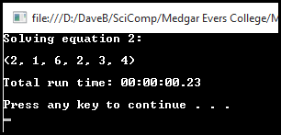

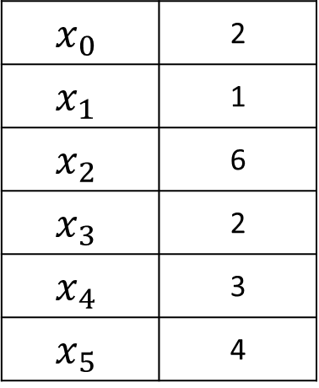
Chemistry is Optimization
$$x_{0}MnO_{4}^{−}+x_{1}H_{2}O_{2}+x_{2}H^{+}→x_{3}{Mn}^{2+}+x_{4}O_{2}+x_{5}H_{2}O$$
$$2MnO_{4}^{−}+H_{2}O_{2}+6H^{+}→2{Mn}^{2+}+3O_{2}+4H_{2}O$$
$$x_{0}$$ | 2
$$x_{1}$$ | 1
$$x_{2}$$ | 6
$$x_{3}$$ | 2
$$x_{4}$$ | 3
$$x_{5}$$ | 4

Slide 8
Chemistry is Optimization
We have transformed solving a chemical equation into a solving a linear optimization problem
The Simplex method is a known good approach to solve linear programming problems in reasonable time
However managing slack variables and the tableau algorithm can be intimidating for novice programmers
Like the code to factor a quadratic equation, can we enumerate the search space (defined by all permutations of coefficients subject to the constraints) in order to find all of the possible solutions?

Slide 9
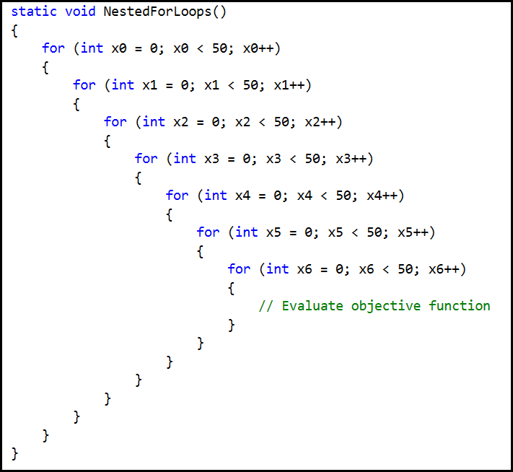
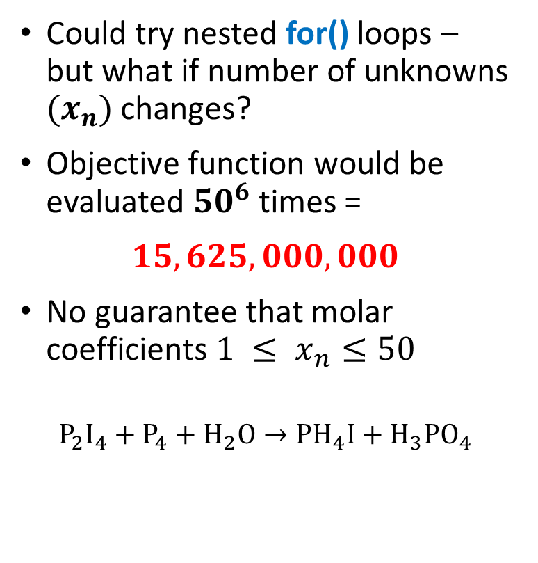
Exponential Explosion in Search Space
Could try nested for() loops – but what if number of unknowns $(x_{n})$changes?
Objective function would be evaluated ${50}^{6}$ times =
$$15,625,000,000$$
No guarantee that molar coefficients $1 ≤ x_{n}≤50$
$$P_{2}I_{4}+P_{4}+H_{2}O→PH_{4}I+H_{3}PO_{4}$$

Slide 10
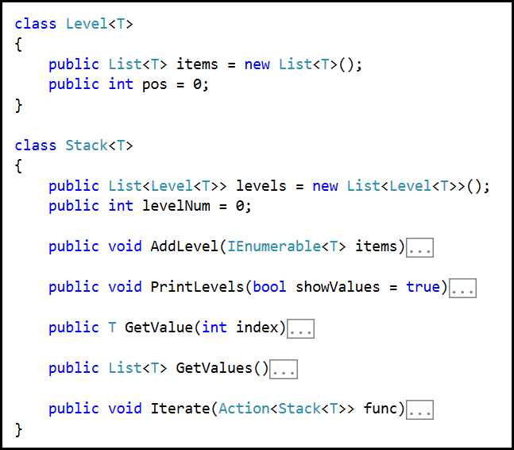
Using Data Structures vs. Using Code
A Level<T> holds an array of items of type T
We track what is the current position (pos) index in each level
A Stack<T> holds an array of levels
We track what is the current level (levelNum) within the stack

Slide 11
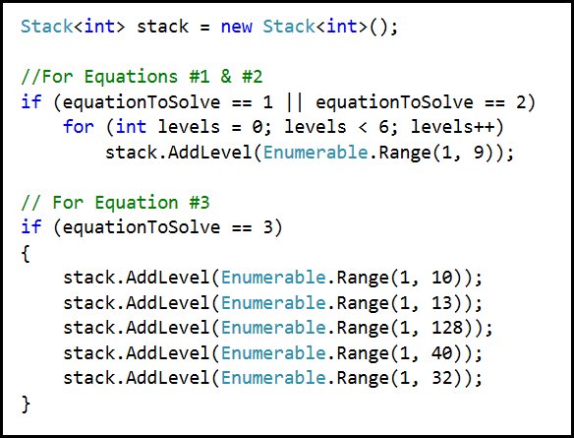
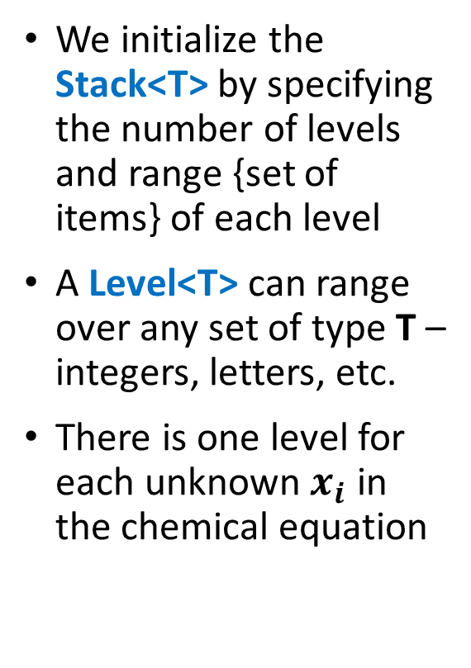
Using Data Structures vs. Using Code
We initialize the Stack<T> by specifying the number of levels and range {set of items} of each level
A Level<T> can range over any set of type T – integers, letters, etc.
There is one level for each unknown $x_{i}$ in the chemical equation
Every level has the same range
Every level has different ranges

Slide 12
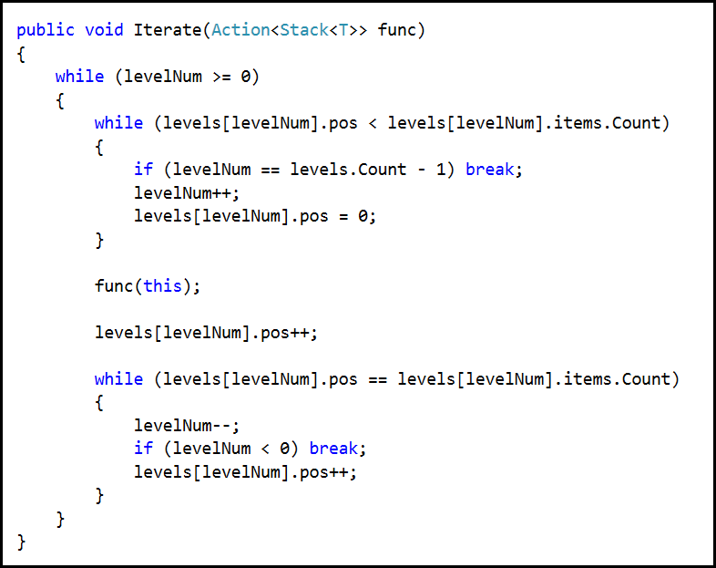
Using Data Structures vs. Using Code
Invoke the objective function
Find the lowest level in the stack which has not yet enumerated its full range
Use the next item in this level’s range
Walk up the stack, skipping all parent levels that have already completed their range

Slide 13
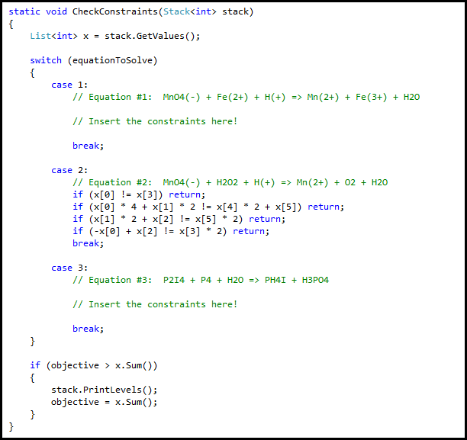
Using Data Structures vs. Using Code
Each molar coefficient is represented by the index to its int[] array value
Display solutions with ever decreasing objective function values

Slide 14
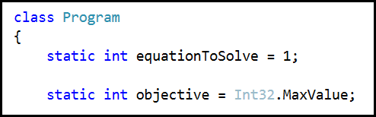
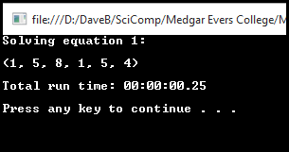
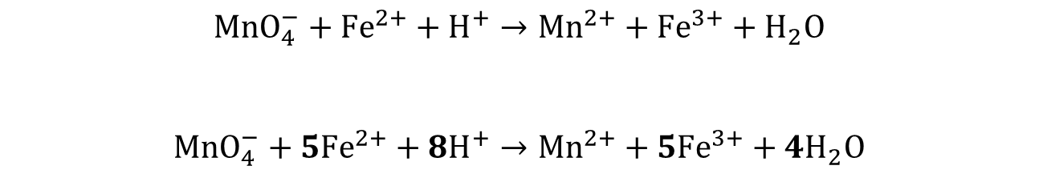
Lab 1 – Balancing Ionic Equations
Change program to solve equation # 1
$$MnO_{4}^{−}+{Fe}^{2+}+H^{+}→{Mn}^{2+}+{Fe}^{3+}+H_{2}O$$
$$MnO_{4}^{−}+{5Fe}^{2+}+{8H}^{+}→{Mn}^{2+}+{5Fe}^{3+}+{4H}_{2}O$$

Slide 15
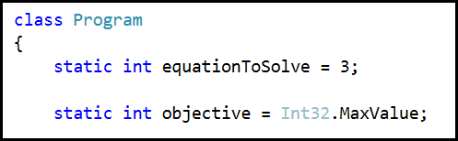
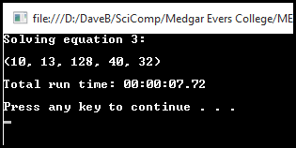
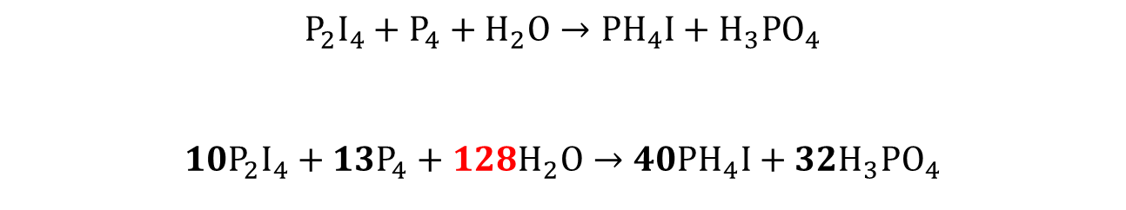
Lab 1 – Balancing Ionic Equations
Change program to solve equation # 3
$${P_{2}I}_{4}+P_{4}+H_{2}O→PH_{4}I+H_{3}PO_{4}$$
$${10P_{2}I}_{4}+{13P}_{4}+{128H}_{2}O→40PH_{4}I+{32H}_{3}PO_{4}$$

Slide 16
Now you know…
We can transform balancing ionic equations to a linear program, which can be solved using brute-force if the search space is sufficiently small
Even relatively simple equations can exponentially increase the search space & using nested for() loops makes the code too brittle
It is better to use the Simplex method, and normalize any rational solutions back to all integers for the final answer

